Slide 1

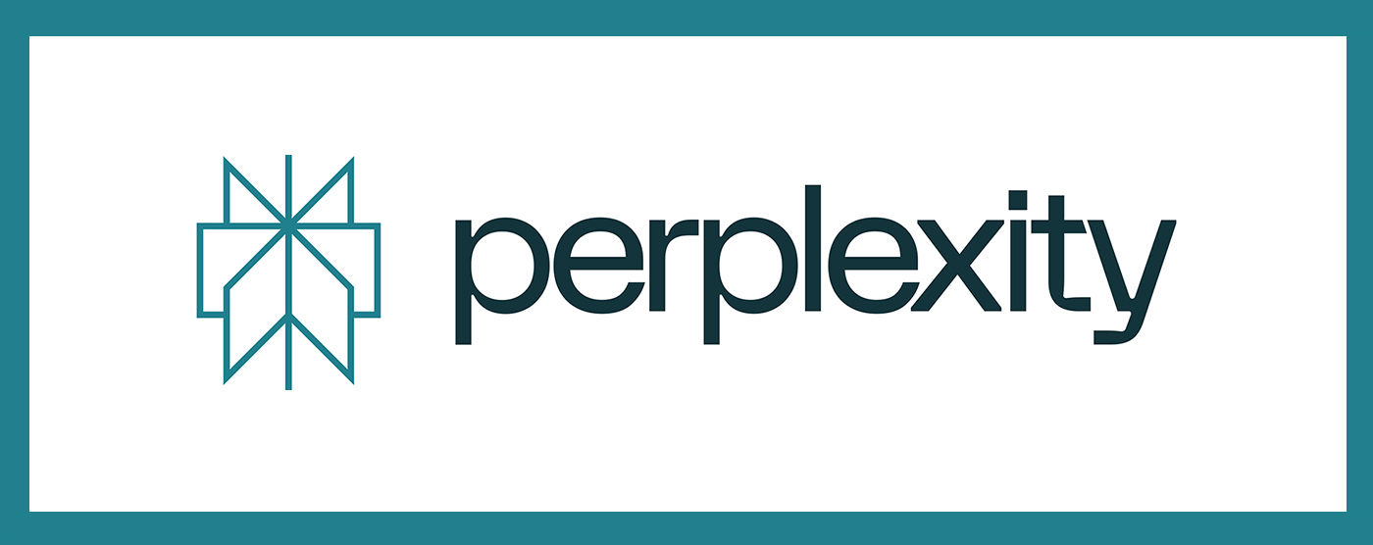

PERPLEXITY AI
Perplexity AI is a leading AI-driven platform providing real-time, context-aware insights, helping businesses make data-driven decisions.
CREATED BY: ANSUMAN PATNAIK

Slide 2
PROBLEM STATEMENT Title: The challenge of extracting meaningful insights from complex Data
The exponential growth of data has made it increasingly difficult for businesses to extract actionable insights.
Traditional methods of data analysis are often time-consuming, expensive, and prone to human error.
There's a critical need for AI solutions that can quickly and accurately interpret vast amounts of data to drive business decisions.

Slide 3
THE SOLUTION Title: Introducing Perplexity AI: Your AI-Powered Data Companion
Perplexity AI leverages advanced language models to provide instant, accurate insights from complex data sets.
Our platform automates the process of data interpretation, saving businesses time and resources while improving decision-making.
Key features: Natural Language Processing (NLP), Real-time Data Analysis, and Context-Aware Insights.

Slide 4
THE SOLUTION – PART 2 Title: How Perplexity AI Works
Data Input: Perplexity AI accepts data from various sources (text, structured data, APIs).
AI Processing: Advanced machine learning algorithms analyse and interpret the data.
Output: The platform delivers clear, actionable insights tailored to the specific needs of the user.
Use Cases: Market analysis, customer sentiment analysis, business forecasting, and more.

Slide 5

THE PRODUCT Title: Perplexity AI Product Overview
Product Features:
Real-time insights generation
Seamless integration with existing data sources
Customizable dashboards and reporting tools
User Experience:
Intuitive interface designed for ease of use
Interactive visualizations for deeper data exploration
Customer Testimonials:
Include quotes from current users praising the product.

Slide 6
BUSINESS MODEL
Revenue Streams:
Subscription Model:
Freemium Plan: Basic search capabilities for free to attract a broad user base.
Premium Plan: Advanced features, including custom insights and API access for enterprise clients.
Price Tiers:
Basic: Free
Pro: $29/month
Enterprise: Custom pricing depending on usage and integration needs.
API Monetization:
Charging developers and businesses for API calls, based on volume and complexity.
Data Licensing:
Selling anonymized data insights to third parties, such as market research firms.

Slide 7
BUSINESS STATISTICS
Annual Recurring Revenue (ARR) (Hypothetical):
1
Assuming 10,000 Pro users: $3.48 million/year.
Assuming 50 Enterprise clients: $2.5 million/year.
Customer Acquisition Cost (CAC):
2
Estimated CAC for SaaS businesses: $150 - $400 per customer.
Lifetime Value (LTV):
3
Average LTV: Estimated at $900 for Pro users.

Slide 8
MARKET STRATEGY
Target Markets:
Technology & SaaS:
High demand for AI-driven insights in product development, customer engagement, and competitive analysis.
Financial Services:
Utilizing AI for market analysis, risk management, and personalized customer services.
E-commerce:
Leveraging AI to enhance customer experience, personalization, and inventory management.

Slide 9
MARKET STRATEGY
Marketing Channels:
Digital Marketing:
SEO & Content Marketing: Targeting keywords around AI, data insights, and competitive intelligence.
PPC Campaigns: Focused on attracting enterprise clients through Google Ads, LinkedIn, and targeted display ads.
Partnerships:
Collaborations with leading CRM platforms, cloud providers, and data analytics companies.
Thought Leadership:
Hosting webinars, publishing whitepapers, and participating in industry conferences.

Slide 10
MARKET STATISTICS
Total Addressable Market (TAM):
AI-driven analytics market projected to reach $40.6 billion by 2027.
Marketing Budget Allocation:
40% on digital advertising, 30% on content creation, 20% on partnerships, and 10% on events and sponsorships.
Growth Rate:
Targeting 20% market penetration within the first 3 years.

Slide 11
COMPETITIVE ANALYSIS
Key Competitors:
OpenAI (ChatGPT):
Strength: Advanced natural language capabilities, large user base.
Weakness: Focused on general use; less specialized in business intelligence.
Google Bard:
Strength: Integration with Google’s ecosystem, vast resources.
Weakness: Still in experimental phases, with limited enterprise focus.
Wolfram Alpha:
Strength: Strong in computational knowledge, deep database.
Weakness: Less user-friendly, more focused on technical queries.

Slide 12
PERPLEXITY AI’S ADVANTAGE
User-Centric Design: Focused on providing actionable, business-centric insights.
Customizable Solutions: Tailored to meet the specific needs of different industries.
Faster Implementation: Quicker to deploy with lower integration costs compared to competitors.

Slide 13
COMPETITIVE STATISTICS
Market Share Estimates:
Perplexity AI: 5% (growing at 2% quarterly).
OpenAI: 35%.
Google Bard: 25%.
Wolfram Alpha: 15%.
Customer Satisfaction Scores:
Perplexity AI: 4.5/5.
OpenAI: 4.3/5.
Google Bard: 4.0/5.
Wolfram Alpha: 3.8/5.

Slide 14
TRACTION
User Growth:
Current User Base: Over 100,000 active users (hypothetical).
Monthly Growth Rate: 15% month-over-month growth.
Revenue Milestones:
Year 1: $1 million ARR.
Year 2: Projected $5 million ARR.
Key Partnerships:
Integration with Major Platforms: Collaborations with platforms like Salesforce, Slack, and Microsoft Teams.
Enterprise Clients: Signed major contracts with companies in fintech, e-commerce, and healthcare.

Slide 15
TRACTION STATISTICS
Customer Retention Rate:
85% retention rate for Pro and Enterprise clients.
Product Usage:
Average user spends 30 minutes/day on the platform, with a 60% daily active user rate.
Media Coverage:
Featured in TechCrunch, Forbes, and AI Magazine.

Slide 16
PERPLEXITY AI & HP!!
Innovation and AI Leadership:
Advanced NLP capabilities
Supports HP’s tech innovation goals
Enhanced Customer Experience:
Personalized, actionable insights
Real-time analytics
Scalability and Integration:
Enterprise-ready and scalable
Seamless integration with HP’s infrastructure
Market Expansion Opportunities:
New revenue streams
Cross-selling potential
Strategic Synergy:
Shared AI vision
Strengthens competitive edge

Slide 17

CONTACT INFORMATION
ANSUMAN PATNAIK (EXTERN)
Email: ansu1p89k@gmail.com
Phone: +1-551-229-8215
LinkedIn: https://www.linkedin.com/in/ansumanpatnaik/
GitHub: https://github.com/Ansuman21
Medium: https://medium.com/@ansumanpatnaik

